Slide 1
Neck trauma
DR:Mariwan latif fatah
M.B.ch.B F.I.C.M.S

Slide 2
INTRODUCTION
Neck injuries are a relatively uncommon presentation in the emergency departments, with variation across different geographical areas owing to differences in patient demographics.
They account for 5–10% of all trauma. Their evaluation and management can be challenging, especially for the inexperienced doctor, because of the complexity of the neck anatomy, which includes vital structures in a confined space

Slide 3
Introduction of diagnostic tools such as flexible endoscopy, high quality oesophagography, angiography and duplex Doppler have improved nonoperative evaluation of aerodigestive and vascular injuries.

Slide 4
THE TRAUMA PATIENT: GENERAL PRINCIPLES
Primary survey (survival assessment)
The primary survey is an initial assessment of factors that cause early deaths in trauma patients.
It focuses on factors such as hypoxia, hypovolaemia, tension pneumothorax and head injury.

Slide 5
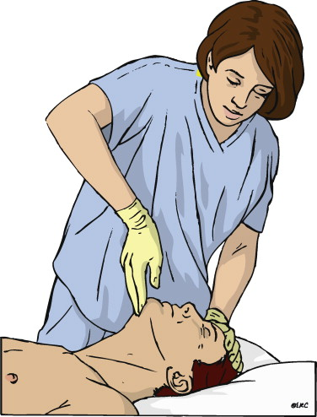
AIRWAY AND CERVICAL SPINE PROTECTION
The patient is examined for evidence of airway obstruction, which may present as stridor and use of accessory muscles.
A chin lift and jaw thrust procedure should be performed.

Slide 6
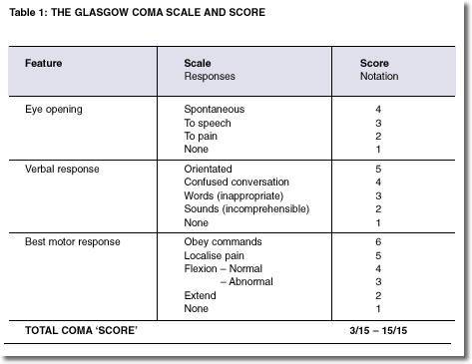
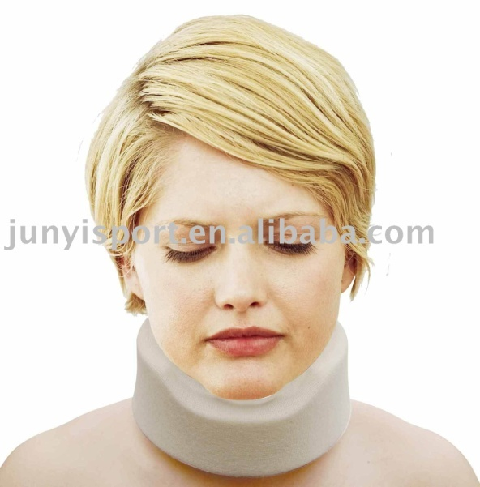
A cervical collar or sandbags should be used to stabilize the neck until cervical spine injury is excluded.
Patients with Glasgow coma scores (GCS) of < 8 usually require intubation to protect the airway.

Slide 7
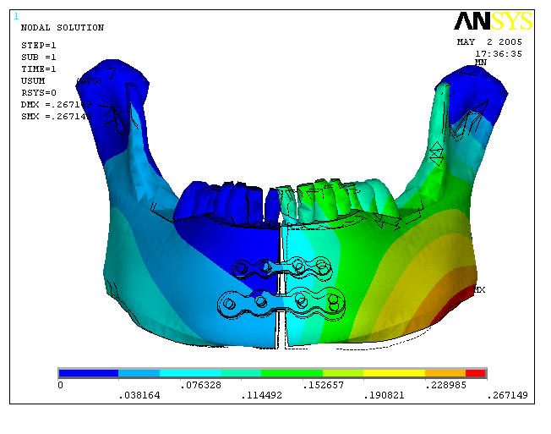
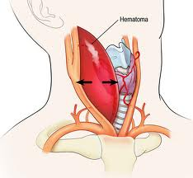
Major facial fractures in particular mandibular fractures and large cervical haematomas may compromise the airway.

Slide 8
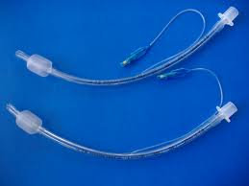
Patients with transcervical gunshot wounds may not have airway problems initially, but must be closely observed as airway obstruction can rapidly develop.
An endotracheal tube may sometimes be inserted directly into the trachea through the site of a penetrating cervical injury.

Slide 9
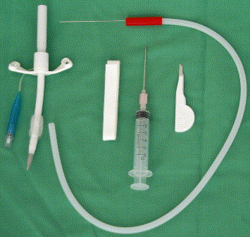
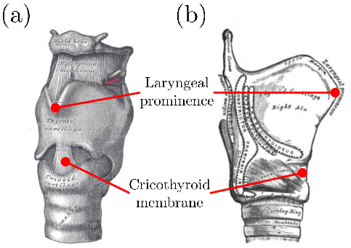
Cricothyroidotomy must be considered if intubation fails.

Slide 10
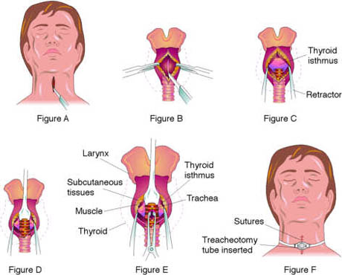
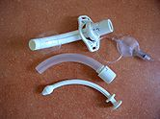
It should be converted to a formal tracheostomy subsequently as the small tube is difficult to keep clean and in order to prevent subglottic stenosis

Slide 11
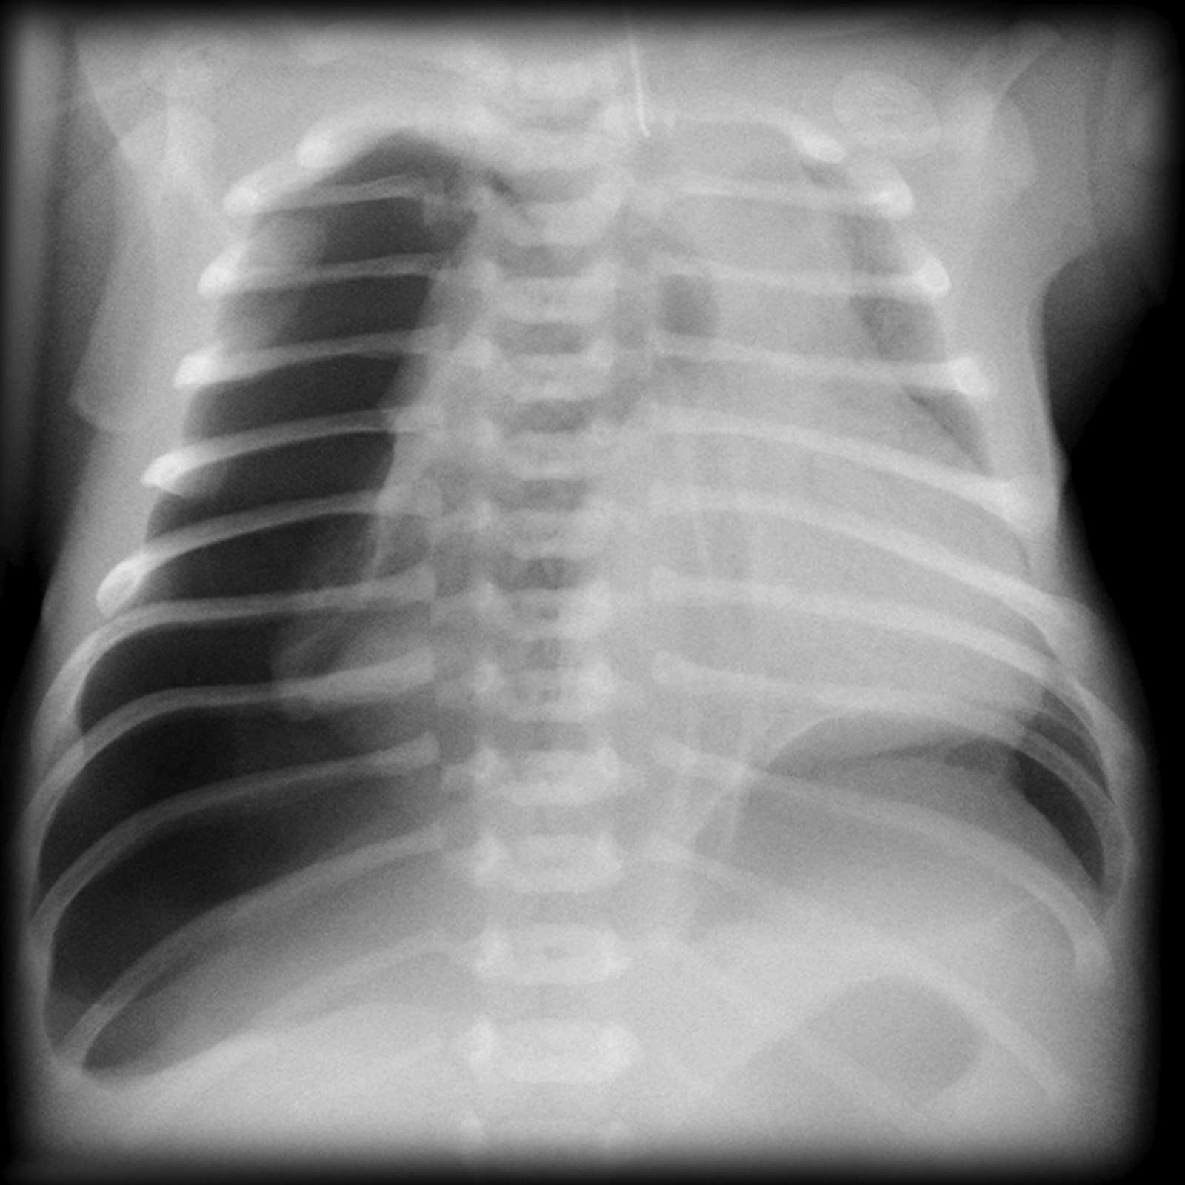
BREATHING
The chest should be examined with respect to movement and air entry.
Tension pneumothorax presents with hypoxia, restlessness, hyper-resonance to percussion, decreased air entry, contralateral tracheal shift and elevated jugular venous pressure.

Slide 12
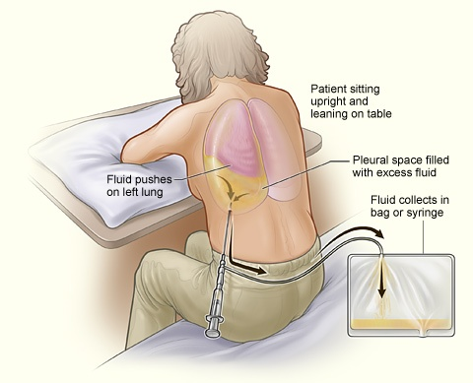
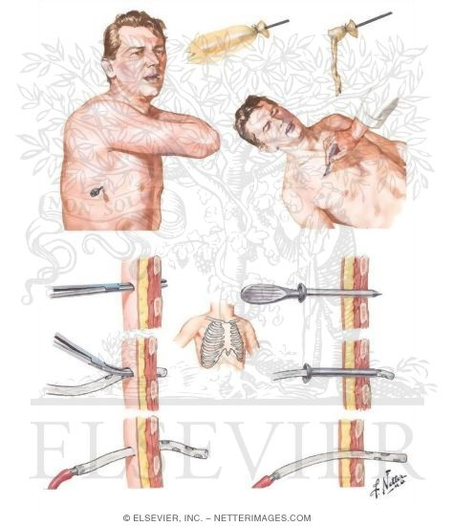
It is decompressed by needle thoracocentesis with a large bore needle placed through the second intercostal space in the midclavicular line, followed by insertion of a chest drain.

Slide 13
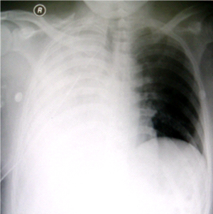
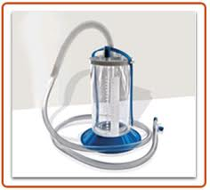
A large haemothorax is identified by dullness to percussion and decreased air entry, and is also managed with an intercostal drain.
These are clinical diagnoses of life threatening conditions and immediate intervention is mandated before x-rays are obtained.

Slide 14
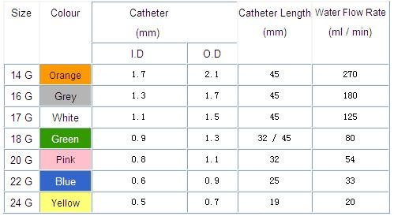
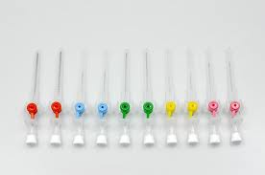
CIRCULATION AND PERFUSION
Two high-flow lines with 14-gauge cannulae are inserted in the antecubital fossae.
The line should not be inserted on the side of massive bleeding from a vascular injury for if there is a venous injury the fluids delivered will be bled out.

Slide 15
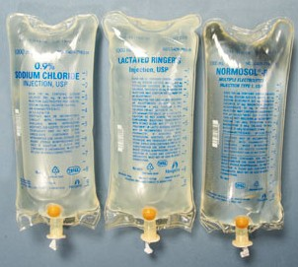
In the shocked patient start with 2 L of crystalloid and proceed to emergency blood (O negative) if the blood pressure does not improve and cross match blood.

Slide 16
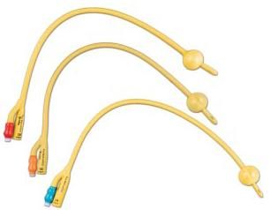
A shocked patient with warm peripheries may have neurogenic shock secondary to spinal cord injury.
Active bleeding from a cervical wound may be controlled with a compressive dressing or digital pressure.
Failing this a large Foley catheter may be inserted into the wound the bulb inflated and the catheter cross clamped to stop blood pouring through the catheter.

Slide 17
This can be a very effective form of haemostasis, particularly with bleeding from the subclavian and cervical vessels.
The patient should remain recumbent, or the neck wound must be covered with an occlusive dressing when the patient sits up, to prevent air embolism.

Slide 18
DISABILITY
The GCS and pupil size are recorded, and power in the limbs assessed.
EXPOSURE
All clothes are removed in order to avoid missing associated injuries and the patient is kept warm.

Slide 19
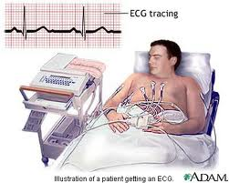
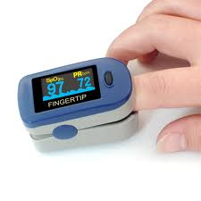
ADJUNCTS TO PRIMARY SURVEY
Adequate monitoring including electrocardiogram, pulse oximetry and non-invasive blood pressure monitoring is instituted.

Slide 20

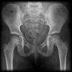
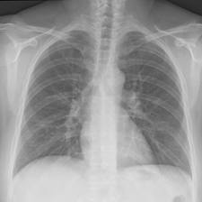
The haemoglobin level, blood glucose and arterial blood gas are checked.
Essential xrays are requested.
In the polytrauma patient this comprises cervical spine, chest x-ray (CXR) and pelvic x-rays.
In a patient with isolated penetrating neck trauma, a cervical spine and CXR will suffice.

Slide 21
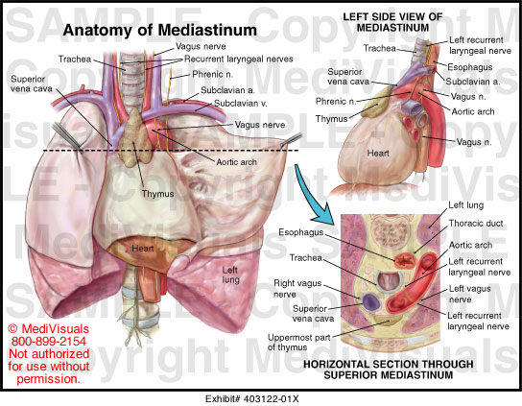
Non urgent x-rays should be requested only on completion of the secondary survey.
Haemo- or pneumothorax, pneumomediastinum (tracheal or oesophageal injury) and widened mediastinum should be excluded.
The mediastinal width on a supine CXR should not exceed 8 cm.

Slide 22
A widened mediastinum is suggestive of a major intrathoracic injury and must be investigated further.
Cervical spine x-ray is used to exclude spinal column injury and prevertebral air (pharyngeal or oesophageal injury) .

Slide 23
Secondary survey
A detailed head-to-foot examination of the patient should be conducted.
In fire arm injuries the entrance and exit wounds must be noted and the tract of the projectile determined to identify which anatomical structures may have been injured.

Slide 24
If an exit wound is not present, then xrays are obtained (anteroposterior and lateral) to locate
the bullet so that the tract of the bullet can be determined.
The cranial nerves should be examined and Horner's syndrome excluded.

Slide 25
Note the presence of large cervical haematomas, subcutaneous emphysema, the jugular venous pressure, the presence of blood in the nasogastric tube and tenderness over the mandible.

Slide 26
Wounds should not be probed as this may result in massive bleeding from an arterial injury.
The peripheral pulses should be checked for discrepancy or absence.

Slide 27
The abdomen and pelvis should be examined, followed by a full neurological examination during which spinal cord and brachial plexus trauma are excluded.
Note the presence of hemiplegia (hemitransection of spinal cord).
The patient should be log-rolled in order that the back can be examined for trauma.

Slide 28
HISTORY
Take a history with specific reference to the nature of the trauma.
Enquire about symptoms related to oesophageal
injury (haemoptysis, haematemesis, dysphagia and odynophagia) and recurrent laryngeal nerve or laryngeal injury (dysphonia, stridor),
Past medical and surgical history are documented, as well as the time of the patient's last meal.

Slide 29
FURTHER INVESTIGATIONS
Any further x-rays that are required after the secondary survey are now completed. Special investigations such as angiography, computed tomography (CT) scan, ultrasound and gastrograffin/barium studies may now be performed in a haemodynamically stable patient.
FULL DOCUMENTATION
All injuries are documented and the patient is referred for definitive care.

Slide 30
AETIOLOGICAL CLASSIFICATION
Unlike stab wounds and low velocity gun shot wounds , close-range shotgun, rifle and bomb injuries cause extensive soft tissue trauma:
penetrating
stabs
gun shot wound (GSW)
low velocity
high velocity
shotgun
blast
blunt

Slide 31
ZONES OF THE NECK
Roon and Christensen's classification is most commonly used for description of the site of cervical trauma .
The neck contains three principal anatomic components:
vascular (carotid, vertebral and subclavian arteries, jugular and subclavian veins)
digestive (pharynx and oesophagus)
respiratory (larynx and trachea).

Slide 32
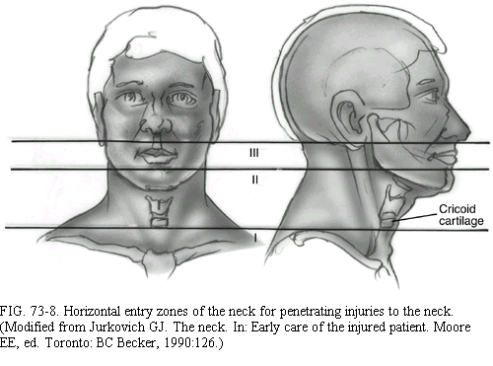
All three zones contain major vascular and aerodigestive structures.
However injuries to zones I and III are both diagnostically and surgically more challenging,

Slide 33
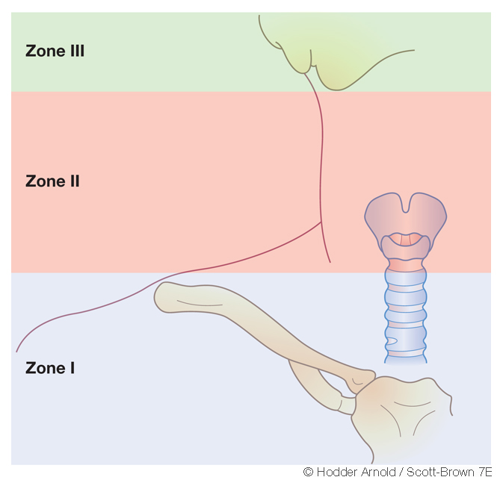
Roon and Christensen classification
Zone I :sternal notch/clavicle to cricoid cartilage.
zone II: cricoid cartilage to angle of mandible.
zone III: angle of mandible to base of skull.

Slide 34
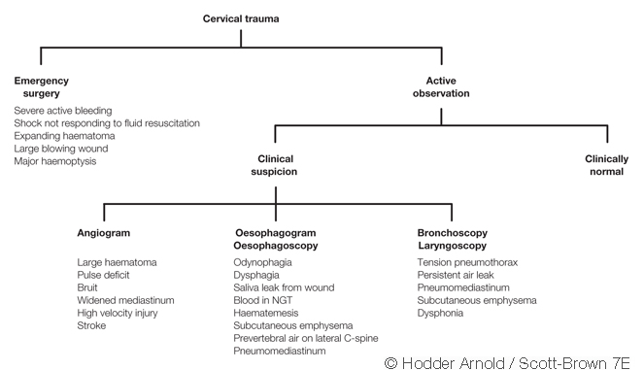
(Selective surgical exploration algorithm)

Slide 35
Vascular injuries in zones I and III can be difficult to assess clinically.

Slide 36
Reference
Scott brown-ENT textbook
Logan turners – disease of ear , nose and throat

Slide 37
THANKS

